Slide 1
Extending the LabVIEW CI Service and LabVIEW CI Project Builder

Slide 2


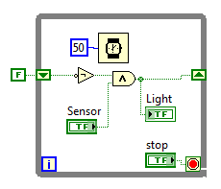
The User Experience
Build Server with:
Jenkins
CI Service
LabVIEW (for builds)
Development Systems:
CI Project Builder
LabVIEW (for development)
Notes:
The LabVIEW Continuous Integration Project consists of two parts.
The LabVIEW CI Service resides on your Jenkins server. Jenkins invokes the CI Service to perform operations in LabVIEW, such as executable builds or unit testing.
The LabVIEW CI Project Builder resides on your developers’ machines. It enables developers to easily configure a CI Project without having to interact directly with Jenkins.
The shipping version of the CI Project supports two job types: LabVIEW Build and Run VI. Additional job types are available from National Instruments Systems Engineering, and you have the option to make your own.
To add a new job type, you must create an extension. To do so, you must create a new web method for the CI Service, and a new configuration plug-in for the CI Project Builder.

Slide 3
Extending the LabVIEW CI Service

Slide 4

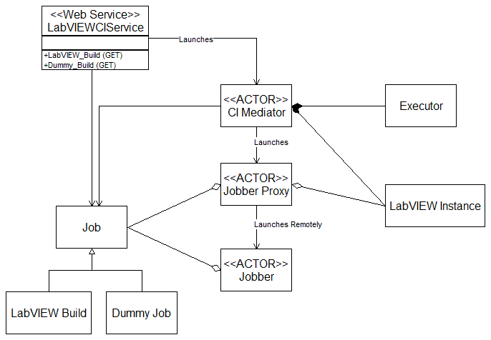
LabVIEW CI Web Service
Jenkins
Notes:
This class diagram displays the structure of the LabVIEW CI Service. JSON data from Jenkins is converted into Job class, which is passed down to a Jobber actor. The Jobber executes the Job.
To add a new job type to the CI Service, you create a new Job class, and a new method for the web service to invoke that job. The following slides outline the procedure.
Note that while the service is built with Actor Framework, no knowledge of AF is required to extend the Service.

Slide 5
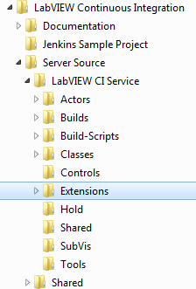
Creating a New Job Type
Notes:
Most of the code for your new job type will reside in <applications>\LabVIEW Continuous Integration\Server Source\LabVIEW CI Service\Extensions.

Slide 6
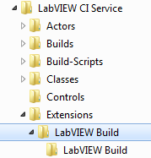

Add Job Folder to Extensions Folder
New Job Class
New Web Method
Notes:
Create a folder for your new job type. That folder will contain two items: a folder for the class that implements the job, and a web service VI that invokes the job.

Slide 7
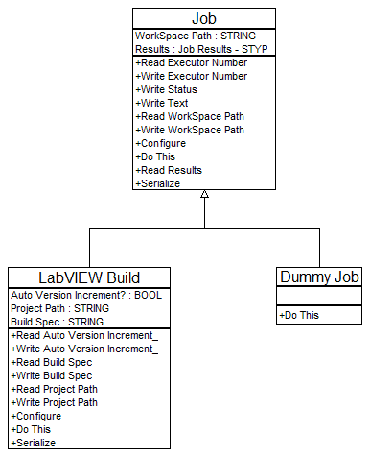
Creating a New Job Type
Notes:
Create a new class, and change it to inherit from Job.
At a minimum, you will create two methods for this new class. You will create a Configure method that converts a JSON string into an instance of the job, and a Do This method that does the actual work. Do This is an override of Job:Do This.

Slide 8
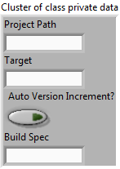
Add Attributes to the Extension Class
Notes:
Add any attributes you need to your new job’s private data.

Slide 9
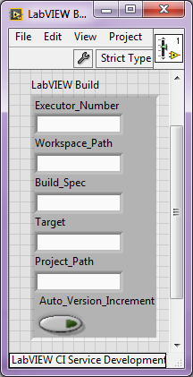
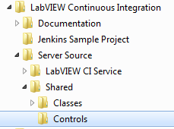
Create a Custom Control for Your Job
Notes:
Create a custom control for your new job.
This control is a strict typedef. The control is a cluster. Any attributes of your job that are configured by the user prior to running the job should be included in the cluster. Note that you must include the Executor_Number and Workspace_Path strings, as these are required by the framework.
Add the control to the <applications>\LabVIEW Continuous Integration\Server Source\Shared\Controls folder. The contents of this folder are shared by the CI Service and the CI Project Builder.

Slide 10
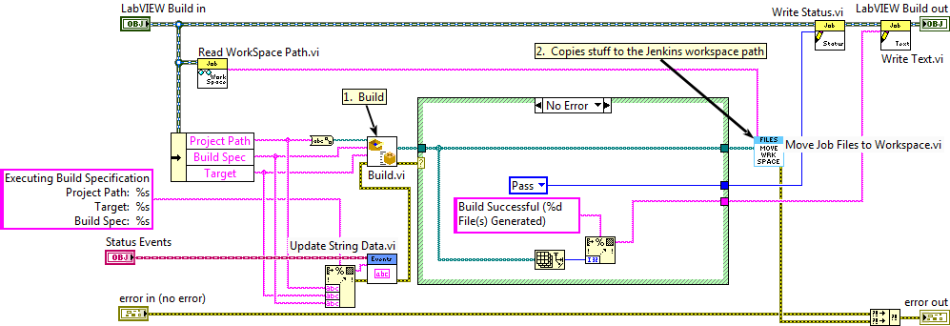
Create a Do This.vi
Notes:
Create an override of Do This.vi. Populate the new method with whatever work needs to be done.
This is the block diagram for LabVIEW Build.lvclass:Do This.vi. In addition to invoking Build.vi, this method invokes a number of CI Service framework VIs.
The Workspace is the folder where Jenkins expects to find the artifacts created by your Job. Use Read Workspace Path.vi to obtain this folder. Note that it is stored as a string, not a path.
Move Job Files to Workspace.vi moves the artifacts created by your job to the workspace. If you want to archive your artifacts, you need to do this.
Use Write Status.vi to return the job’s result to Jenkins. The options are Service Error, Abort, Fail, or Pass. Jenkins needs this value to show the job’s status, so this step isn’t optional.
Use Write Text.vi to return additional information about the results of the job. Optional, but highly desirable.
The Jobber displays a progress bar and text status updates for the jobs it runs. If you wish, you can update these indicators by accessing methods of the Status Events object. Update String Data.vi will append a block of text to Jobber’s status window, and Update Numeric Data will set the value of the progress bar. Note that the progress bar shows percent complete, and thus has a range of 0 to 100.
All of these VIs can be found on the CI Service palette, shown later in this document.

Slide 11
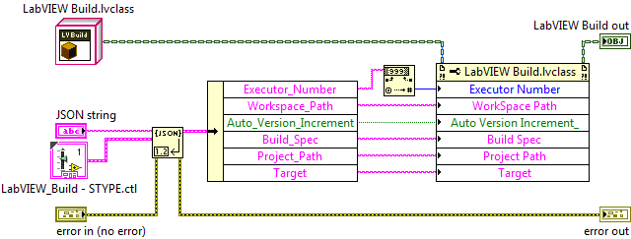
Create a Configure VI
Notes:
You will need to create a configuration VI for your job. The configuration VIs are static dispatch VIs, so you do not override a method of Job.lvclass to create one.
Add a static dispatch method to your job class, and name it Configure <my class name>.vi.
As shown here, your configure VI takes a JSON string as input, unflattens that string to the strict typedef you defined earlier, and writes that data to attributes of your job. The VI returns a configured instance of the job.

Slide 12

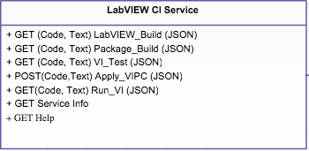

Jenkins – LabVIEW Interaction
HTTP
Notes:
You need to build a web method to invoke your new job.

Slide 13

Create a New Web Method
Notes:
To create a new web method, open the LabVIEW CI Service project, and navigate to My Computer\LabVIEW CI Service\LabVIEWCIService\Web Resource. Right click, and select New Web Resource. Complete the new VI as shown.
Alternately, you can create the VI by hand. You can find the LabVIEW Web Request object at <applications>\National Instruments\LabVIEW 2014\vi.lib\wsapi
Send Launch Job and Wait for Reply can be found on the CI Service palette.
Save the VI in <applications>\LabVIEW Continuous Integration\Server Source\LabVIEW CI Service\Extensions\<my job>.
Important Note: The automated build tool for the CI Server automatically adds web methods to the web service. For this reason, we recommend you remove any web methods from the web service prior to rebuilding the service.

Slide 14
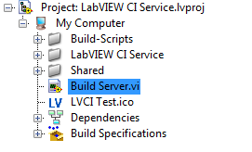
Rebuild the CI Server
Call this VI to build the CI Server
Notes:
The final step to adding a new job to the CI Service is to rebuild the service. Run Build Server.vi again.
Build Server.vi will automatically add your new extension to the CI Service, build the service, and install it.
Important Note: uninstall the current version of the CI Service before rebuilding it. Use Control Panel » Programs and Features to uninstall LabVIEW Continuous Integration. Do not uninstall Jenkins or the CI Service VI package.

Slide 15
Extending the LabVIEW CI Project Builder

Slide 16
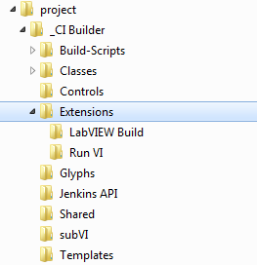
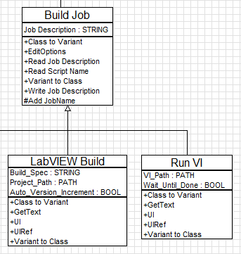
Creating a New Job Type Configuration Node
Notes:
Like the CI Server, we built the CI Project Builder to be user-extensible.
You add a new job type by creating a child of Build Job, and adding that child to the <LabVIEW>\project\_CI Builder\Extensions folder. The CI Project Builder will automatically detect the new job and make it available to add to your CI project.
We strongly recommend you give these classes names that relate to, but are different from, their CI Server counterparts. For Example, the CI Project Builder extension for the LabVIEW Build job is called LabVIEW Build Node.vi. (Yes, the UML diagram on this slide is slightly out of date.)
You need to write five VIs. Four of them are overrides of Build Job methods.

Slide 17
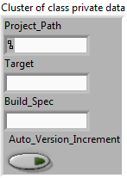
Create a New Build Job Class
Notes:
The attributes of your new build job will be all of the user-configurable attributes of the new job. Typically, this is a subset of the attributes of the job class you created for your CI Server.

Slide 18
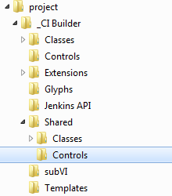
Create a Custom Control for Your Job
Notes:
You will need to place a copy of the custom control for this job in the <applications>\LabVIEW 20xx\project\_CI Builder\Shared\Controls folder.
This is the same custom control you created for the CI Server extension.

Slide 19
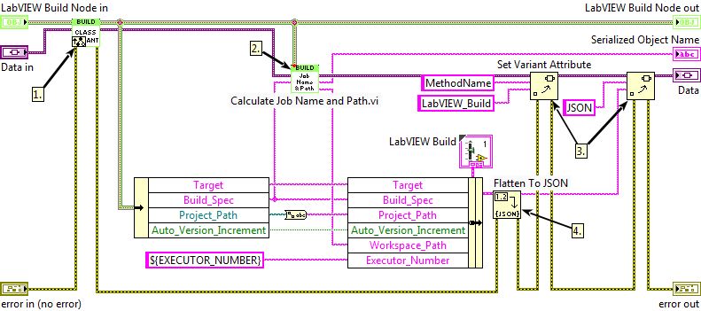
Serialization
Notes:
You need to override Class to Variant.vi, the VI that serializes the job data. This VI is used when writing job data to a file or to Jenkins.
This VI makes use of a property bag, which is just a variant database. Data to be serialized is added as attributes to a data variant; the serialization VIs convert this data variant to text of the correct format.
This is the block diagram for LabVIEW Build.lvclass:Class to Variant.vi It illustrates some important details about the serialization process.
You must call the parent node of this VI, and you should call it before you add any other attributes to the variant. The parent node adds its attributes to the variant; other class methods access these attributes to do their work, and you can as well.
Calculate Job Name and Path.vi returns the full job name and recommended workspace path for your job. The job name is displayed in Jenkins as the title of the job. The VI takes a Job Target string as input. The extensions produced by NI SE use a derivative of some unique configuration detail of the job. The LabVIEW Build uses the name of the build specification, the VI Analyzer job uses the name of the Vi Analyzer configuration file, and so on. We recommend you do the same. (If your job does not generates any artifacts, you can use the simpler Add JobName.vi, which only generates the Jenkins job name.)
You only need to add two attributes to the variant database. The first is MethodName, which is just the name of the web method you created for this job. The second is the JSON string that will be passed to the method.
The JSON string is flattened from an instance of the custom control you created for the CI Server extension. Populate this control with attributes from your build job class and the output of Calculate Job Name and Path.vi. Note also that Executor_Number must always be set to “${EXECUTOR_NUMBER}.

Slide 20
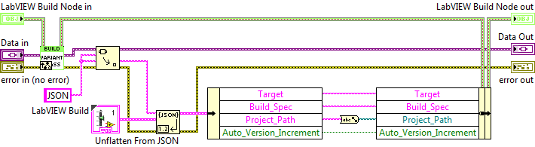
Deserialization
Notes:
You also need to provide an override of Variant to Class.vi, the VI that deserializes job data. This VI is used when loading job data from file.
As with Class to Variant.vi, you must call the parent node, and we strongly recommend you call it before any other operation on the data variant.
JSON is the only attribute you need to retrieve. Use your extensions’ custom control to unflatten the data, and then write it to your class’ attributes. Since Executor_Number and Workspace_Path are calculated or fixed, you don’t need to save them to class data.

Slide 21
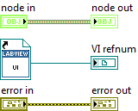
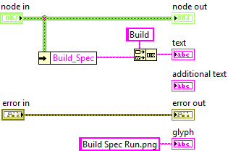
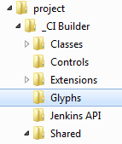
Display Overrides
UIRef.vi
GetText.vi
Static reference to UI
Notes:
You need to provide overrides for two VIs used by the CEF, GetText.vi and UIRef.vi. GetText.vi provides display text and an optional display glyph. UIRef.vi launches the user interface for the job.
Several glyphs are provided for you in the ..\_CI Builder\glyphs folder. If you opt to provide your own, be sure to add it to the glyphs folder.

Slide 22
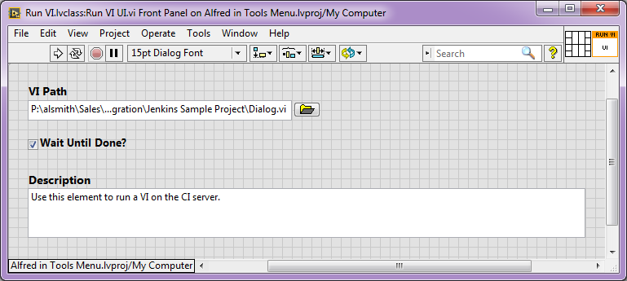
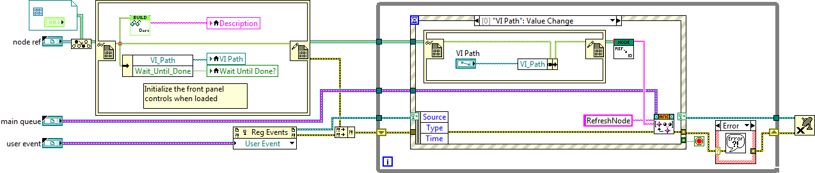
User Interface
Notes:
UIRef.vi returns a static reference to a UI VI. This is the VI that appears in the right pane of the CI Project Builder.
The job UI is the final VI you must provide. It’s a little fiddly, but we provide a template to get you started.
Make this VI part of your new job node class.
If you are writing a new job to correspond to a new CI Server method, that’s it. You can write jobs that manipulate Jenkins in some other way, like the CI Project and Initialize jobs; they are a bit more complicated, but follow the same pattern.

Slide 23
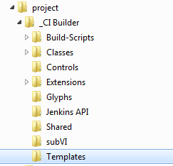
User Interface
Notes:
You can find the template in the CI Project Builder’s “Templates” folder. It’s called Job UI.vit.

